Slide 1
K Nearest Neighbours (KNN)
Complete Notes with a Full Numerical Example
Ananda Rimal
AI Researcher
Machine Learning Lecture
Ananda Rimal
(Machine Learning Lecture)
KNN
1/14

Slide 2
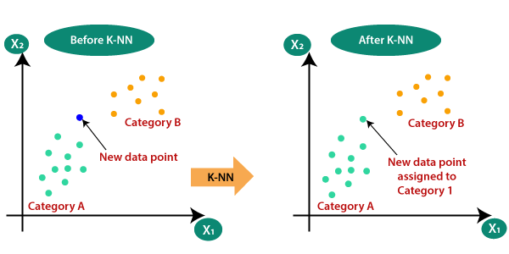
KNN at a Glance
Ananda Rimal
(Machine Learning Lecture)
KNN
2/14

Slide 3
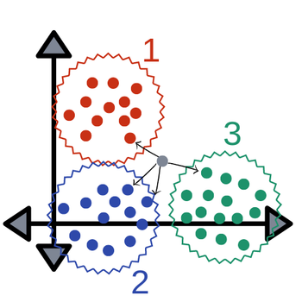
Points Form Groups: A New Point Joins the Nearest Group
Ananda Rimal
(Machine Learning Lecture)
KNN
3/14

Slide 4
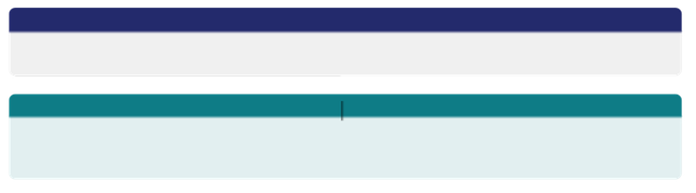
What is KNN?
Simple definition
KNN is a supervised algorithm that classifies a new point by looking at its K closest existing points and taking a majority vote.
Think of it like this
“Tell me who your closest friends are, and I will guess who you are.” You move to a new school and want to guess if a student likes football. Look at his 5 closest friends. If 4 of them like football, he probably does too. That is KNN.
▶ KNN is called a lazy learner: it does no training at all. It just stores the data and works only
when a new point arrives.
▶ It can do classification (majority vote) and regression (average of neighbours).
Ananda Rimal
(Machine Learning Lecture)
KNN
4/14

Slide 5
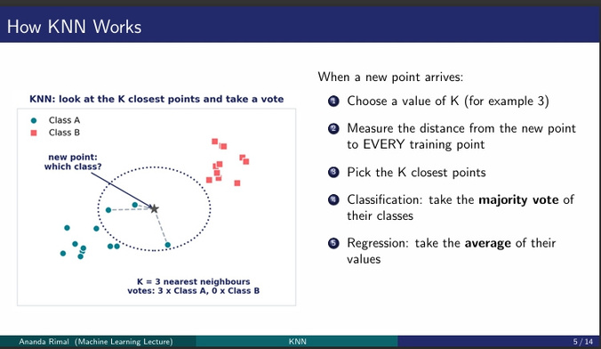

Slide 6

Where is KNN Used?
▶
Recommendation systems
find users or items most similar to you
▶
Credit scoring and fraud
does this transaction look like known fraud cases?
▶
Image recognition
match a new image to its nearest known images
Medical diagnosis
compare a patient to similar past patients
▶
Handwriting and OCR
classic digit recognition benchmark
▶
▶
Search and matching
find the most similar documents or products
One sentence to remember
Any problem of the type “find the most SIMILAR things” is a nearest neighbour problem.
Ananda Rimal
(Machine Learning Lecture)
KNN
6/14

Slide 7

Real Products That Use Nearest Neighbour Ideas
▶
Spotify: music recommendations. Spotify even built and open sourced its own nearest neighbour library called Annoy to find similar songs and users fast.
Amazon style “customers also bought”: item to item recommendations are built on finding the nearest (most similar) products.
Netflix: early recommendation engines used nearest neighbour collaborative filtering: users similar to
you liked this movie.
Face unlock and photo search: a face becomes a vector (embedding), and the system finds the nearest stored face vector to identify the person.
Modern AI search (vector databases): tools like FAISS (from Meta) and Pinecone run approximate nearest neighbour search on millions of embeddings. This powers semantic search and chatbot memory today.
▶
▶
▶
▶
Note
At big scale, products use APPROXIMATE nearest neighbours (ANN) for speed, but the core idea is exactly the KNN idea you learn here.
Ananda Rimal
(Machine Learning Lecture)
KNN
7/14

Slide 8
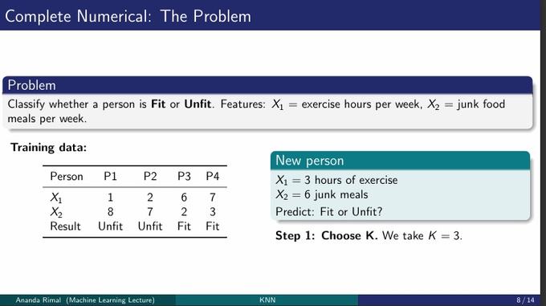

Slide 9
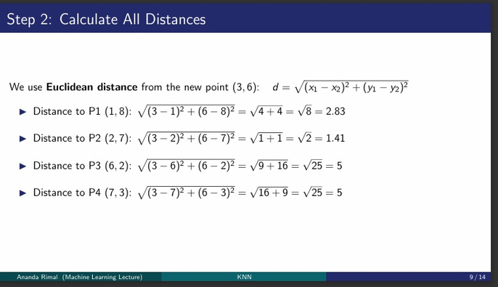

Slide 10
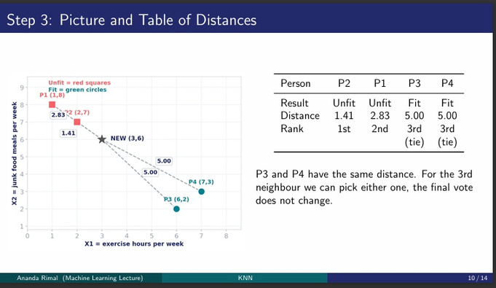

Slide 11
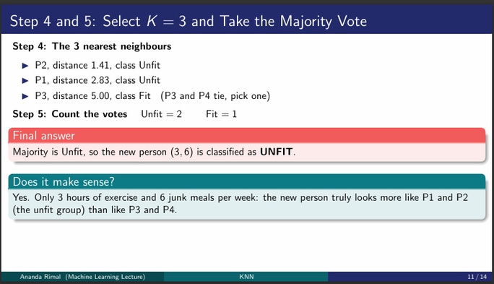

Slide 12
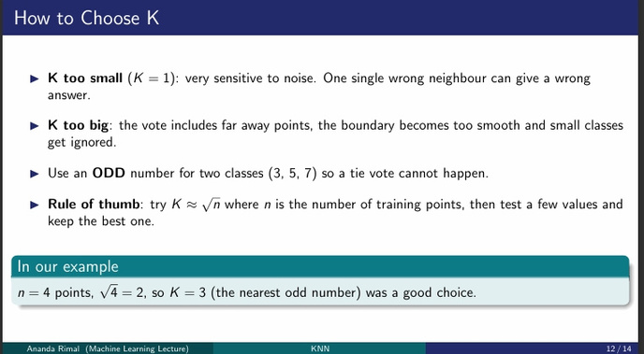

Slide 13
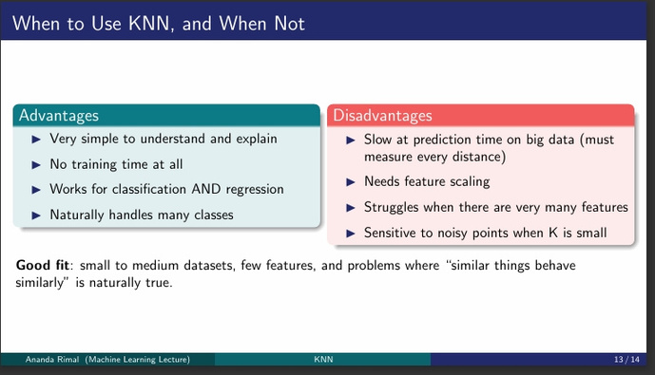

Slide 14
